Slide 1

Java + Mobile course by Enered

Slide 2
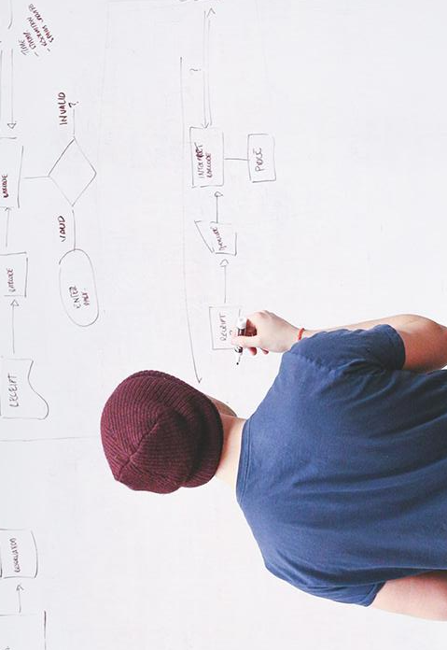
HELLO!
I am Vlad Butnaru
I will be your trainer for this Java session!
PS: It’ll be awesome!

Slide 3
What will we do today
Full game review
Better AI (avoid obstacles)
Create one more mouse
Random map generator

Slide 4
Full game review

Slide 5
Let’s avoid obstacles!

Slide 6
Let’s create one more mouse

Slide 7
Let’s generate a random map

Slide 8
THANKS!
Any questions?
You can find me at:
@web: http://vladbutnaru.com/
@facebook· Vladut Butnaru
@linkedin· Vlad Butnaru
@email : vlad2me@gmail.com
@phone : +40 0754 827 620

Slide 9
Feedback please!
http://bit.do/feedbackvlad

